Slide 1
Using NLP to Predict Customer Satisfaction
RACHEL HOESLEY
DATA SCIENCE
08/18/2022

Slide 2
Background -
Located:
St. Petersburg, Fl
Previous Experience:
2014-20 : Combination of Retail and Service Industries
‘22 : Financial Industry -> Breaking into the ever-growing Tech
Data:
Women's E-Commerce Clothing Reviews | Kaggle

Slide 3
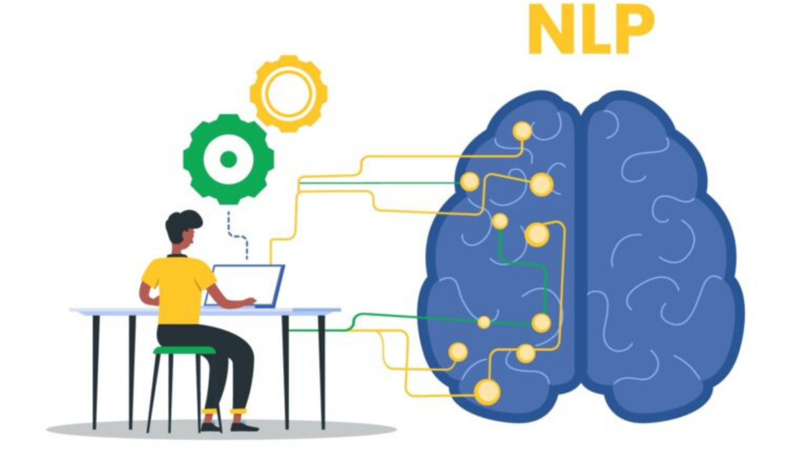
Methods of NLP - an intersection of Artificial intelligence, Computer Science and Linguistics.
- Seven primary techniques of Natural Language Processing:
Named Entity Recognition (NER)
Tokenization
Stemming and Lemmatization
Bag of Words
Natural language generation
Sentiment Analysis
Sentence Segmentation

Slide 4
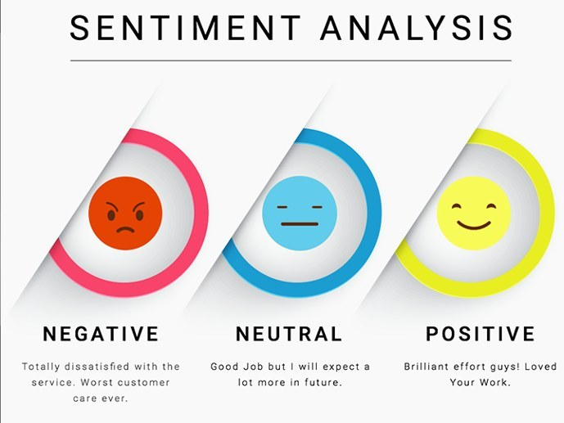
What Is Sentiment Analysis?
- A subset of NLP (Natural Language Processing) using NLTK (Natural Language Tool Kit)
- Used to label the “emotion” within a comment/review; determined in three levels – positive, neutral, negative
- Determined by the polarity score of the text

Slide 5
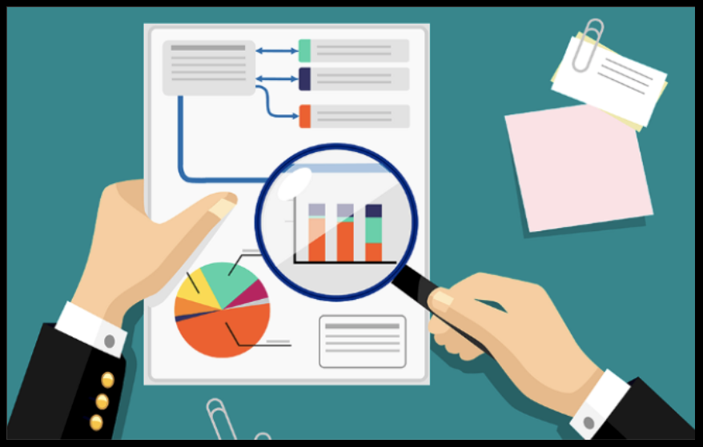
Exploring Data -

Slide 6
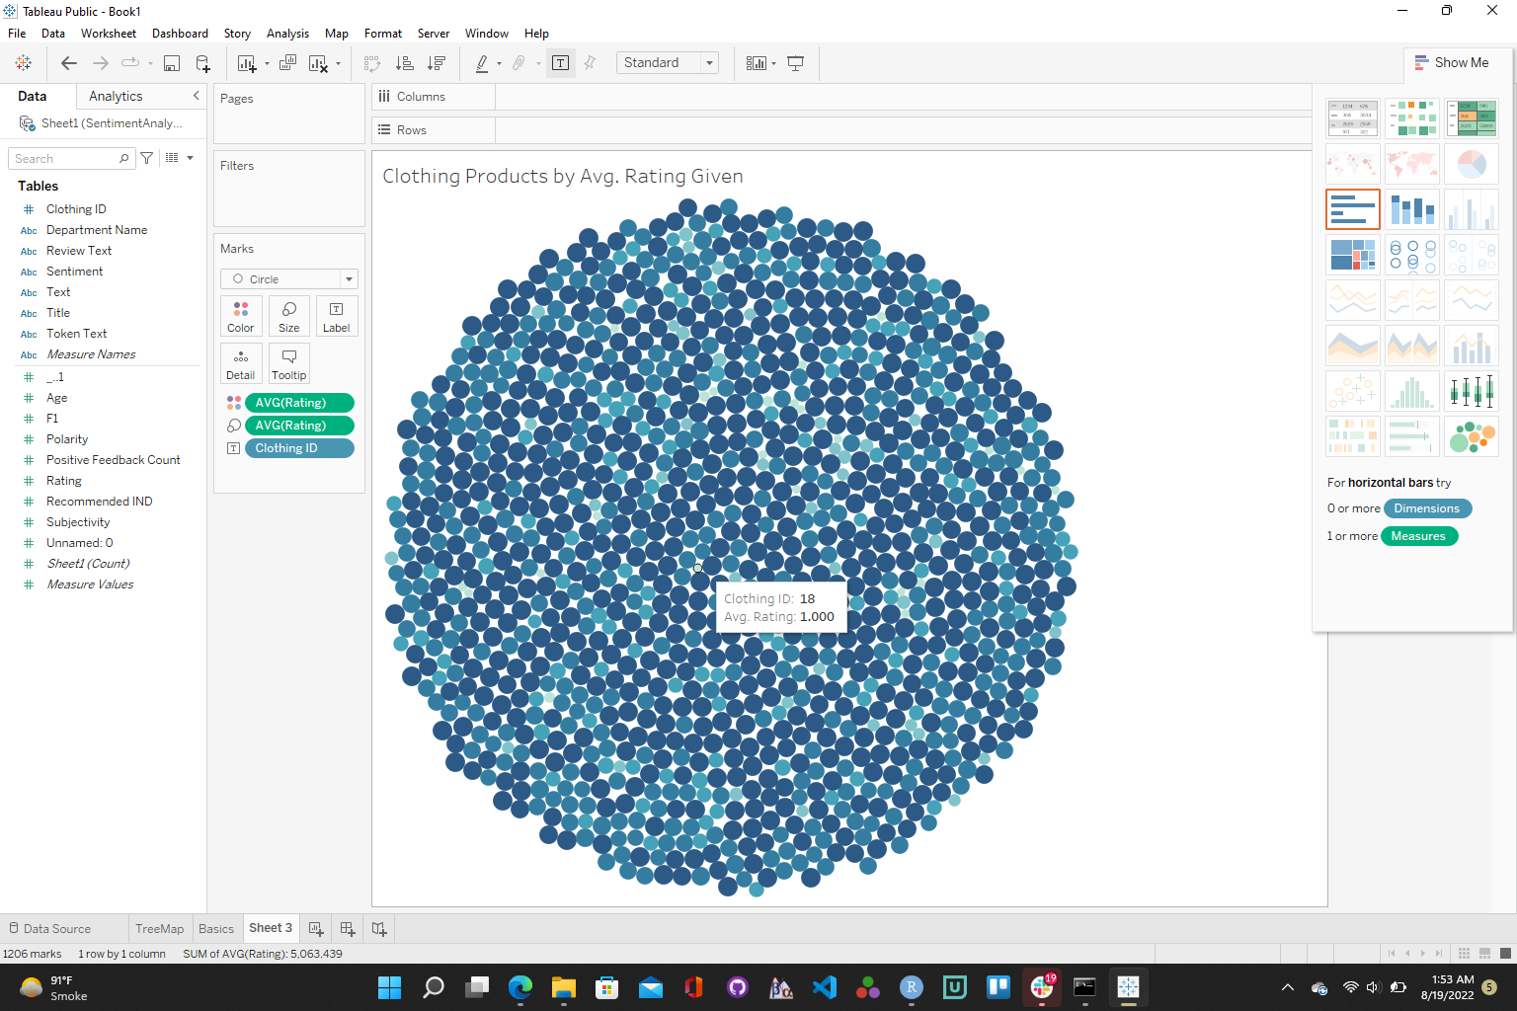
Let’s Explore -

Slide 7
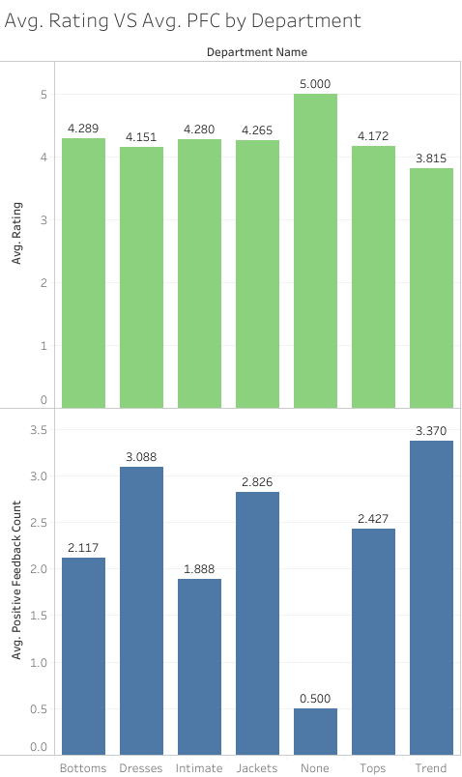
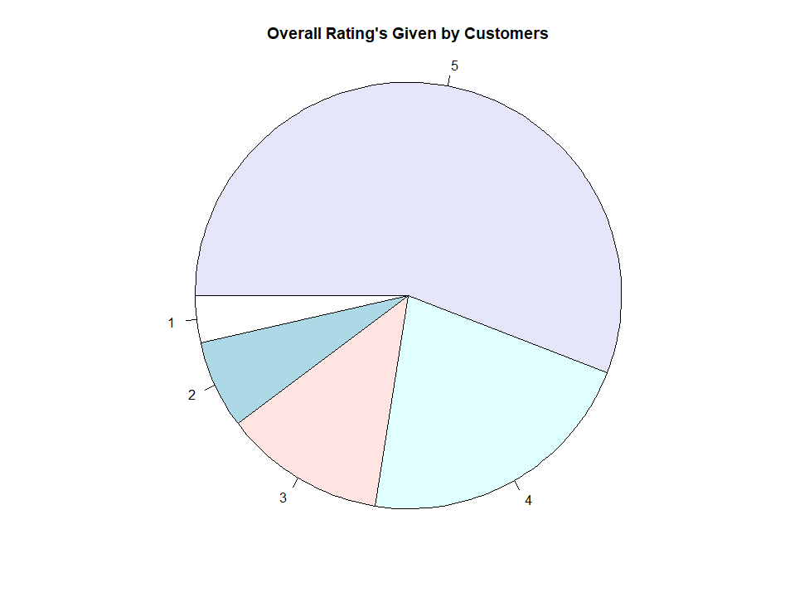
Let’s Explore Cont. -

Slide 8
Exploratory Analysis in Py -

Slide 9
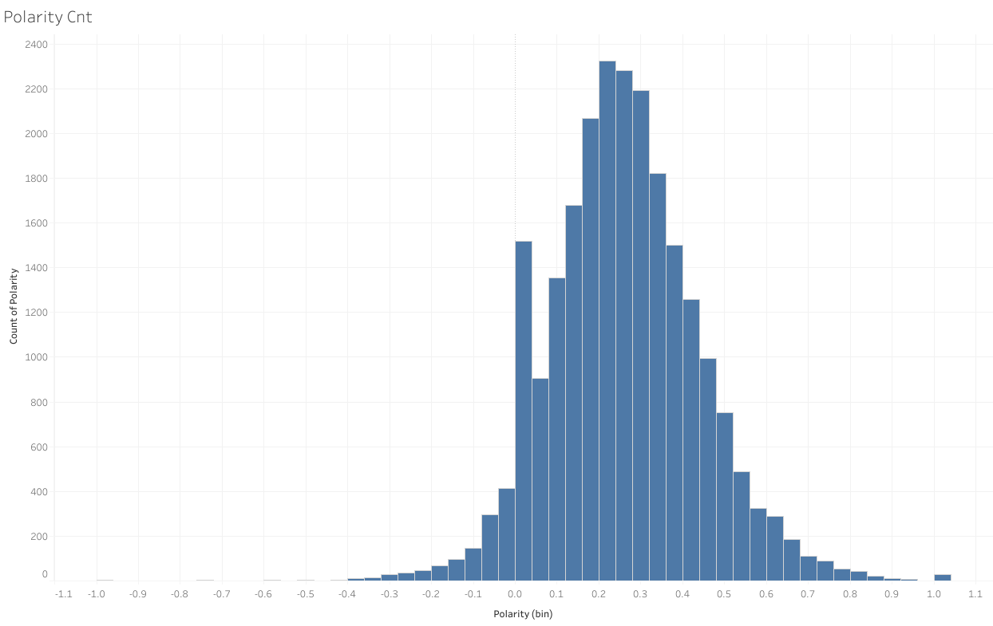
Overall Polarity of Text
Polarity Scale -
Negative = < -0.5
Neutral = -0.5 - 0.5
Positive = > 0.5

Slide 10
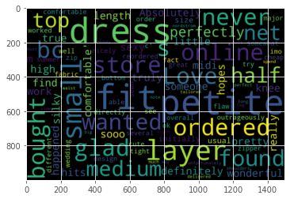
WordCloud
WordCloud can be used as a marketing tool as well!
Also analyze for -
Only Positive Reviews
Only Negative Reviews
Reviews on Specific Departments

Slide 11
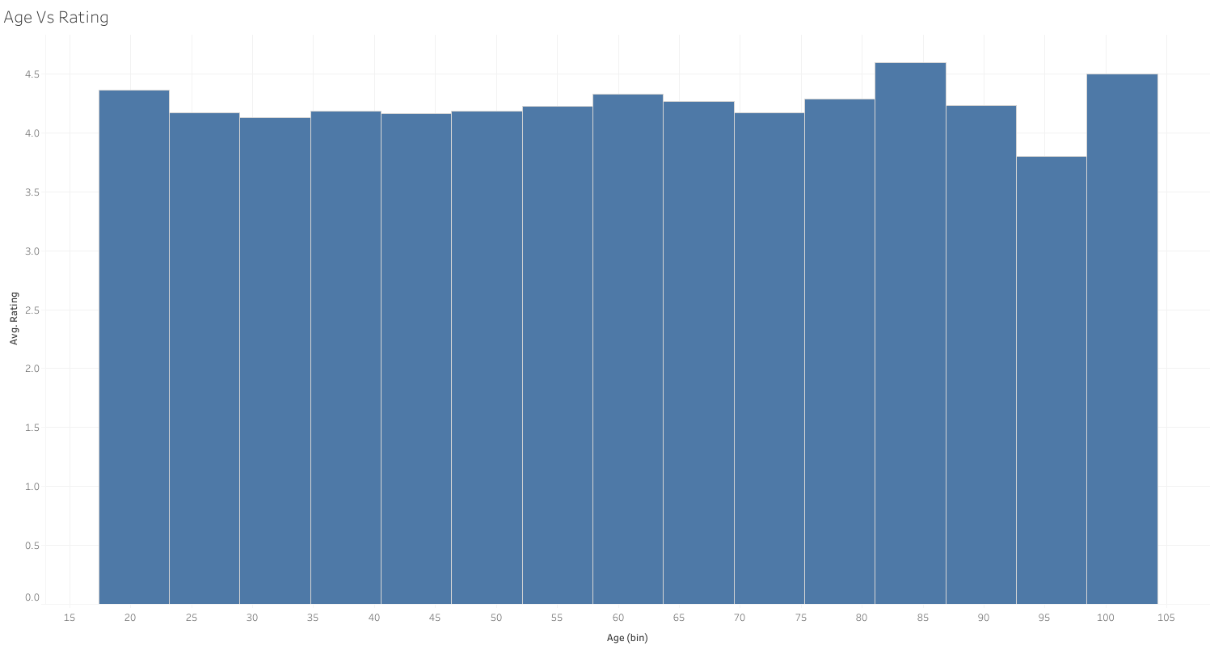
Age Vs Rating

Slide 12
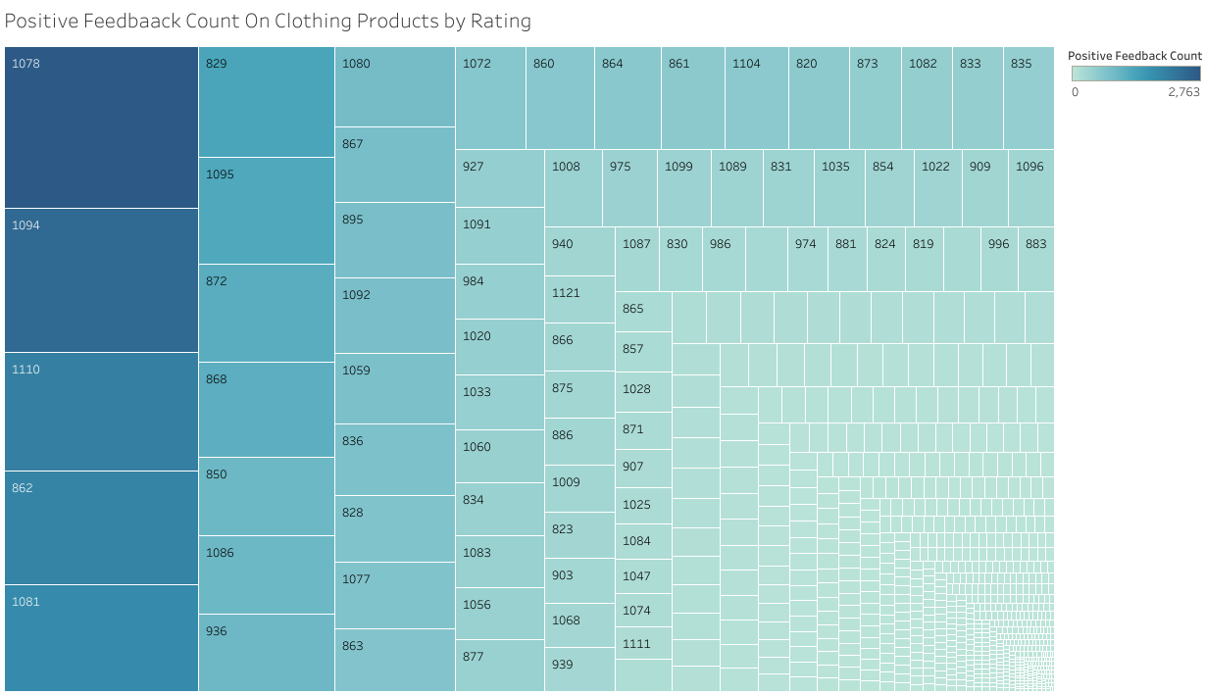
Tree Map to showcase PFC

Slide 13
Credits
Sources:
enterprisersproject.com
Images:
https://www.mentimeter.com/blog/audience-energizers/live-audience-word-clouds
How to Explore Data: {DataExplorer} Package (exploringdata.org)

